Slide 1
Submitting to the: Texas Workforce Commission Eligible Training Provider System (ETPS)
Including
Training Providers
and
Apprenticeships

Slide 2
Interested in Becoming a WIOA Eligible Training Provider (ETP) ? Step 1: Meet Regulatory Requirements
To provide training in Texas, state law requires that the training provider is approved, regulated or …
Qualify for a general exemption from the Proprietary School (Career Schools and Colleges).
Texas Workforce Commission policy indicates that all programs certified by the WIOA Eligible Training Provider System (ETPS) also comply with applicable state law, including Texas Education Code Chapter 132, related to Career Schools and Colleges Department.
You may contact the Career Schools and Colleges Department at (512) 936-3100 regarding status.

Slide 3
Registered Apprenticeship on the ETPS
Boards do not review or determine eligibility for registered apprenticeship programs.
Please contact the ETP helpdesk at: etp.helpdesk@twc.state.tx.us to determine the next steps.
Apprenticeship programs should follow all the steps outlined by the Help Desk and complete an initial application for new programs with TWC.
Once their program application has been submitted, it is routed to the DOL/ETA
The ETP team will send their DOL registration number to the Apprenticeship team for verification.
DOL registered apprenticeship programs have automatic approval for the statewide list. The application is to simply record the program information for the Statewide list.
Once verified, the ETP team will process and send the training provider an approval letter via email.
The ETP team certifies the application and the board should receive a notification and an update of the program on the Statewide list.
Once approved, apprenticeship programs are not subject to: Eligibility, performance reporting, or review by the state or Boards to be approved for the ETPL, as provided in 20 Code of Federal Regulations (CFR) 32 §680.470; or additional local eligibility criteria that Boards may require for other local training providers.
The requirement for training programs to be in occupations that appear on both the statewide and Board target occupations lists does not apply to registered apprenticeship programs.

Slide 4
ETP System
The Legacy ETPS system (automated) is no longer available for external login and submission.
The Texas Workforce Commission (TWC) is in the process of developing a solution as a replacement of the previous automated Eligible Training Provider System (ETPS).
There is now a statewide ETPL with a new submission process.
If you desire to submit programs for access to the statewide ETPL, you may submit with the Alamo (WSA) Board if the training provider is assigned to the Alamo Board.
List of training providers assigned is available on the Workforce Solutions Alamo (WSA) Board website.
If your school is not listed please contact:
Texas Workforce Commission
Workforce Programs & Policy - ETP Unit
ETP.Helpdesk@twc.state.tx.us

Slide 5
For Eligible Training Providers (ETPs) assigned to the Alamo area WSA may:
Update information for existing ETPs and their programs;
Add new locations, or campuses, to existing providers;
Add new Provider programs;
Submit closure requests; and
Add non-ETP programs -(e.g., On-the-Job trainings, other contracts)

Slide 6
What is the Statewide ETPL?
https://twc.texas.gov/partners/eligible-training-providers
Spreadsheet updated twice monthly
Includes all currently approved programs

Slide 7
Information
General programs information, including location and cost
Performance Information

Slide 8
Listed Cost of Programs
The listed cost of a program on the statewide ETPL is based on average cost for non-WIOA students in general.
Where providers and local Boards have arrangements to fund programs at different rates for WIOA students, these costs must be maintained separate from the statewide ETPL.

Slide 9
Board Approved?
Boards review and sends to TWC for approval
Statewide Approval, Local Relationship
Listed by County
Local criteria for students

Slide 10
Expiration?
Created Date/Updated Date
Eligibility reviewed
12-months after initial approval
Every year following performance reporting

Slide 11
Submitting your Application with the Alamo (WSA) Board

Slide 12
ETPL Tools- are provided to Boards For Updates & Initial Applications

Slide 13
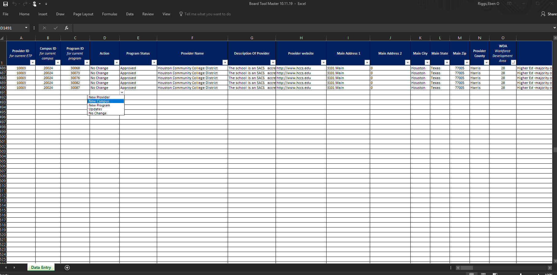
Board Tool- Sample

Slide 14
Board Tool is used to submit updates & initial applications (new programs) to the Texas Workforce Commission.
Providers are Board assigned based on location
ETPs are assigned by default to WDAs based on Main Campus locations, with all campuses falling under that same Board
Board Tool includes a list of all programs for all assigned providers
All programs are listed regardless of status (program status is approved or pending)
Boards use the Board Tool to submit new and updated programs to TWC
May include non-ETP for TWIST

Slide 15
New “Initial” Application? For program currently not listed on the Statewide ETPL For providers assigned and not assigned to the Alamo Board:
New “initial” program submission:
If you are a Texas training providers that is wanting to submit new programs for eligibility consideration:
Alamo WDA (WSA) Board accepts new program applications from providers assigned to the Alamo area. A list of providers is on the WSA Website. Please contact the ETP help desk if your school is not listed. ETP help desk will advise on your assigned Board.
Alamo WDA (WSA) Board accepts new “initial” applications from “new providers” with a physical presence in the Alamo 13 county area, not assigned to a Board. Program format of delivery (instruction) is in-person, distance education or hybrid.
Continued annual reporting of student data applies for continued eligibility.

Slide 16
NEW PROGRAMS APPLICATIONS
Training Provider Approval During the Interim Period
The Texas Workforce Commission (TWC) is in the process of developing a solution as a replacement of the previous automated Eligible Training Provider System.
During this transition, TWC has assigned the Workforce Development Boards to collect and submit for “new providers” or “assigned providers” an initial application for a “new” program of study via a Board Tool & Initial Training Provider Program Report Tool- provided by the Texas Workforce Commission.
If you are a Texas training providers, not assigned to a Board, that is wanting to submit new programs for eligibility consideration your school must have a physical presence in the 13 County Alamo Region.
Step 1: Meet Regulatory Requirements- (Chapter 132 Requirement)
Step 2: Submit evidence you are regulated
For institutions offering post-secondary degree granting programs, submit documentation of accreditation/licensure by a recognized postsecondary institution accrediting body listed on the Texas Higher Education Coordinating Board website or the US Department of Education website.
For institutions granting certificate or technical training, please provide evidence of certification from the Texas Workforce Commission or an equivalent approving body. Provide evidence that you offer tuition-based courses that are available to the general public. Submit your planned mail or delivery date to the Alamo Board OR the appropriate information in an electronic format.
For language and GED/basic skills programs, proof of accreditation from an appropriate accrediting agency must be submitted to the Board. A sample accreditation agency is the Texas Education Agency.
Step 3: The requirement for training programs to be in occupations that appear on the statewide or Board target occupations lists does apply for all new or continuing programs.
Any training providers that submits a new programs for eligibility consideration to the Alamo Board, once the Initial Training Provider Program Report Tool (Application) is submitted and all required items, then, the completed application is submitted to the Texas Workforce Commission for consideration bi-weekly.

Slide 17
Creating an Initial Application
Before you begin ...
To assist you in preparing this application, it may be useful to have the following information:
Workforce Development Area (WDA) –ETPs are assigned by default to WDAs based on Main Campus locations, with all campuses falling under that same Board. Alamo WDA (WSA) Board accepts a new “initial” applications from providers assigned to the Alamo area. If you are a Texas training providers, not assigned to a Board, wanting to submit new programs for eligibility consideration your school must have a physical presence in the 13 County Alamo Region
Institution Type: 1) Higher Education –majority of credentials are associate degrees, 2) Higher Education majority of credentials are baccalaureate or higher degrees 3) Higher Ed-majority of credentials awarded are community college certificate of completion. 4) National Apprenticeship, 5) Private Non-Profit, 6) Private for-profit, 7) Public, 8) Other Type
CIP Code: Code of Instructional Program. You may choose from a drop-down list on the Reference Table Spreadsheet.
Career Schools and Colleges Certification may list related CIP Codes.
Pell Grant Eligibility (yes/no/pending)
Academic (Type)-0)None, 1)High School Diploma or Equivalent, 2) Associate Degree 3) Bachelors Degree, 4) Courses 5) Combination of Education and Courses.
Outcome: Does the program of training services lead to a: Baccalaureate degree, Associate degree, Industry recognized certificate or certificate, Certificate of completion on an apprenticeship, Government license, Community college certificate of completion, Secondary school diploma or its equivalent, No credential-employment only, Measurable Skills gain leading to a credential, Measurable skill gain leading to employment?
Format: Is the training conducted: 1) In-person, 2) Distance Education, 3) Hybrid (both)
SOC-ONET Code: Standard Occupational Code related to the CIP Code. A crosswalk can be found on ONET On-Line: O*NET OnLine https://www.onetonline.org
https://www.onetonline.org/crosswalk/ Go to
Education
Search codes or titles from the 2010 Classification of Instructional Programs (CIP).
This is a CIP Code to SOC Crosswalk.

Slide 18
Next Steps

Slide 19
Letters of Partnerships
FAQ- Answers
Regulatory Evidence
This Photo by Unknown Author is licensed under CC BY

Slide 20
Board Requirements-Important Next Step
This Photo by Unknown Author is licensed under CC BY-SA

Slide 21
Submit Regulatory Evidence
Regulatory evidence may include TWC Career Schools & College school confirmation (or exemption) letter, or similar documents from other regulatory agencies listed on the the Texas Higher Education Coordinating Board or accreditation from the Texas Education Agency.

Slide 22
Employer Partnership Requirement A Texas Workforce Commission (TWC) and Workforce Solutions Alamo(WSA) Board Requirement
A letter or Support from a Local Employer(s) or evidence of an existing employer-based committee must be submitted to the Alamo Board.
The Workforce Innovation and Opportunity Act (WIOA) emphasizes the importance of training services to provide the highest quality of training services and to be responsive to in-demand and emerging industries.
Training providers will need to include proof (documentation) of a business connection/partnership related to the particular training program. WIOA Section 122 (b)(4)(D)(ii). This may include:
Letters of support for each of your programs from external businesses/employers. Each letter must be related to the particular training program.
Or evidence of Industry Groups/oversight committees convened for your programs.

Slide 23
Letter of Support Requirements
Question: Do we have to provide a letter from a potential employer of students stating there is a need for what the students are studying?
Answer: The letter of support must document a partnership with an employer related to your training program, not just the need for what the students are studying.
Question: Would a list of advisory board members or a list of externship/clinic partnerships be adequate?
Answer: If you advisory board membership is employer-based, it then might serve the partnership purpose. However, the intent of letters of support is not just to show that employers are interested in the training but also to show that there is a partnership with employers who are willing to hire those who complete the program.

Slide 24
Letter of Support Requirements
Question: Would one letter of Support for partnership meet the requirements?
Answer Yes one letter of support meets these Requirements
Question: As it pertains to the employer letter of support, what exactly is the employer supporting?
Answer: We are looking for letters of support from local Businesses that show that the training program will help meet their need for qualified workers and thus has value to the student community and local economy.

Slide 25
Approvals
Once the Alamo WDA (WSA) receives all required information from local providers, and they meet the required criteria, then the initial application or updates for existing providers will be submitted to the Texas Workforce Commission.
WSA will submit this information for consideration to TWC. This is done on the first and third Friday of each month.
TWC will review and add (if approved) Alamo local providers programs to the statewide ETPL as pending programs the following week after submission. This is done by the second and fourth Friday of each month.

Slide 26
Next Step--TWC Approval
TWC will review and add (if approved) local providers programs to the statewide ETPL as pending programs the following week. This is done by the second and fourth Friday of each month.
Training programs are required to submit student information to TWC for eligibility to be considered.
For programs without connection to any students – regardless of funding source – the student data requirement may be waived for initial eligibility determinations.
After ETP Help Desk staff add these pending programs to the statewide ETPL, providers will be sent an email with a link to download a student data report and instructions to complete it before submitting it directly to TWC.
Once TWC receives required student data they will activate your local programs on the statewide ETPL.
If not required to submit student data, they will be active when added to the statewide ETPL by TWC.
The statewide ETPL will be updated every second and fourth Friday of each month by TWC.
The most current statewide ETPL has been published at the following address:
https://twc.texas.gov/partners/eligible-training-providers#targetOccupations

Slide 27
Student Data Report (SDR)
Required for most programs
Verifiable student-level
Initial eligibility and annual reporting
Direct to/from TWC

Slide 28
Overview of ETP
This Photo by Unknown Author is licensed under CC BY-SA

Slide 29
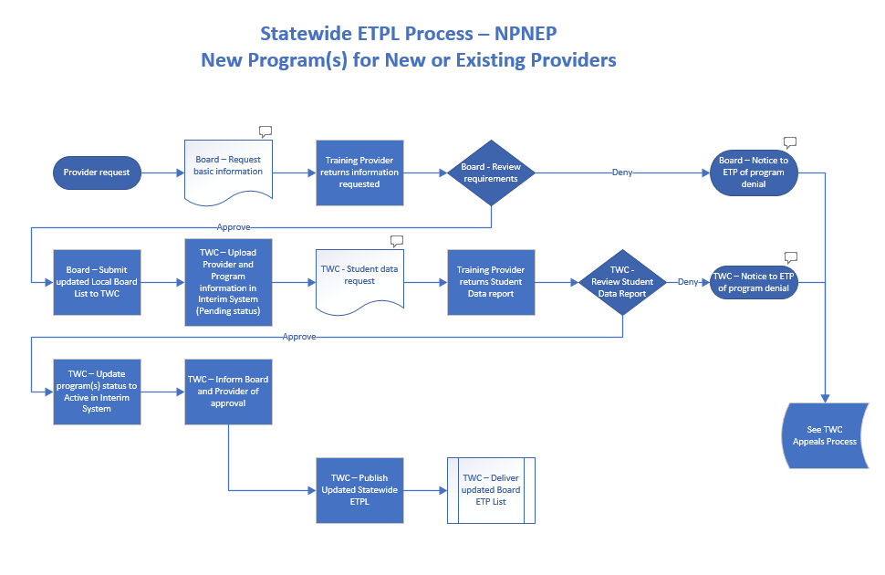

Slide 30
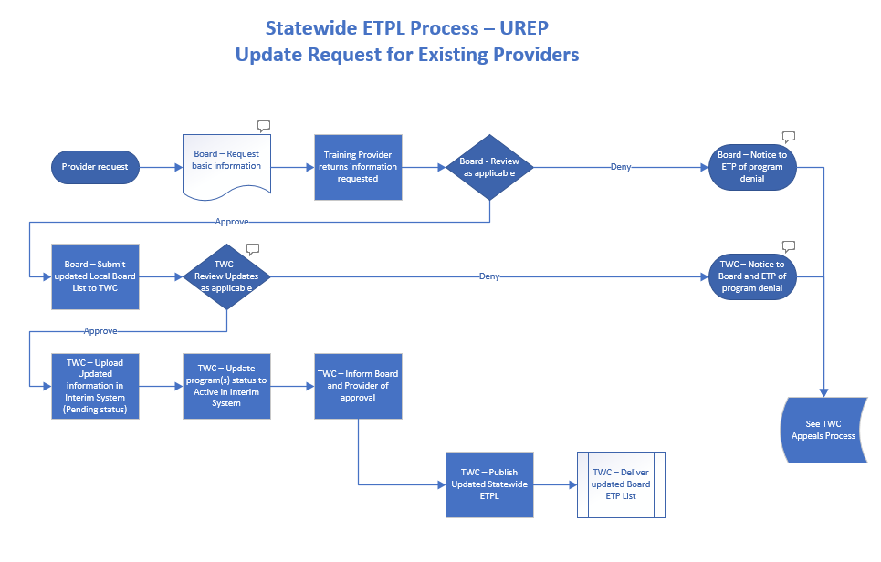

Slide 31
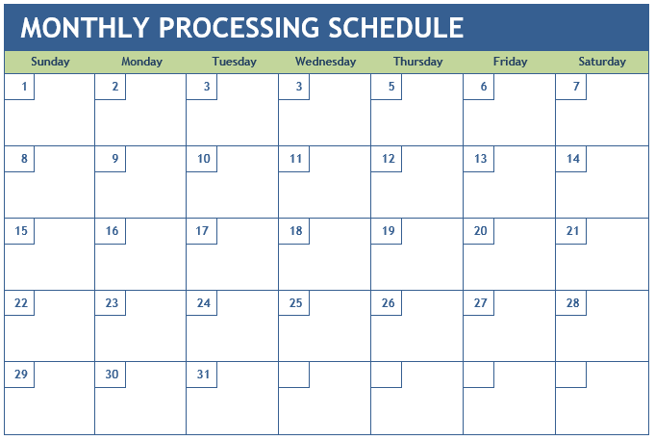
Board
TWC
Board
TWC
Board
Notes:
1st and 3rd Friday: Boards submit tool to TWC
2nd and 4th Friday: TWC processes Board tools and SDRs. Updates statewide ETPL

Slide 32
ETPL ≠ $
Inclusion on the statewide ETPL provides programs access, not funding.
Local Boards fund students through ITAs, in accordance with state and local policies

Slide 33
Or…
State Criteria
ETPL = Providers
ITA = Students
Local Flexibility

Slide 34
Eligible Training Providers page
https://twc.texas.gov/partners/eligible-training-providers
Enhancements in process
ETP Program Guide
Video guides for tool use
Eligibility Criteria (Initial and Continued)
Board ETP contact information
ETP Process Maps

Slide 35
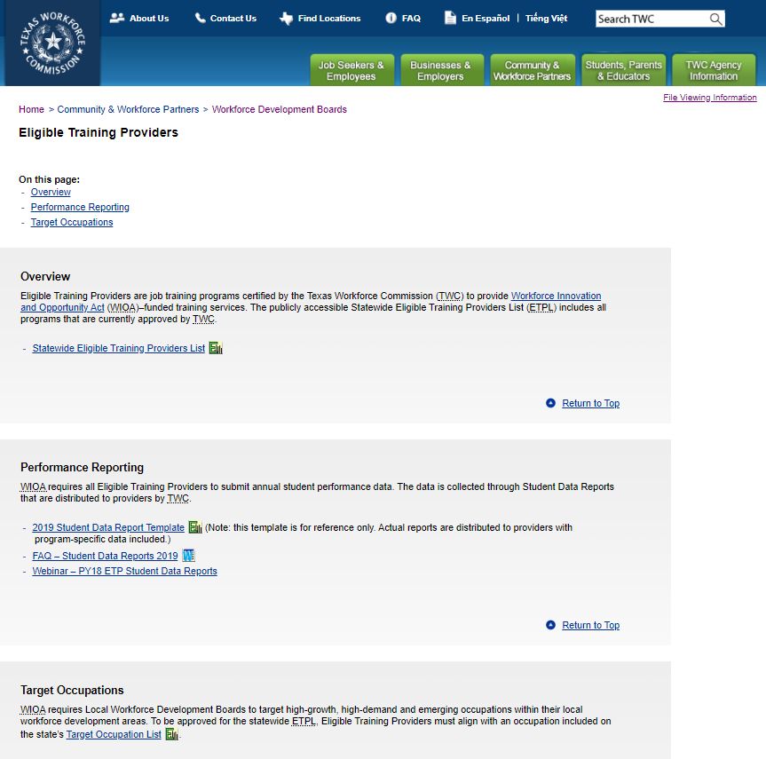
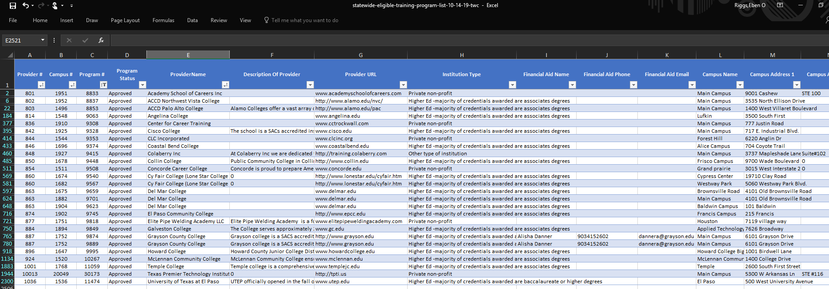

Slide 36
Contact Information
Please call Workforce Solutions Alamo for questions.
Miriam Barksdale Botello
(210) 581-1096
mbarksdale@wsalamo.org
For Assistance With Your Application Contact:
Texas Workforce Commission
ETP Contact:
ETP Help Desk etp.helpdesk@twc.state.tx.us

